Slide 1


ISTSEH
COMPANY REPORT
INJAZ / JA COMPANY PROGRAM
Company
Report
A personalized medication-care platform that combines smart scheduling, safety insights, and family support to help patients manage daily treatment with confidence.
TEAM
UNIVERSITY
DATE
VERSION
ISTSEH
Kuwait University
June 2026
1.0
Notes:
1

Slide 2
ISTSEH
CONTENTS
02 / 31
Table of Contents
01 Executive Summary 03
17 Development Report 19
02 Aim of the Report 04
18 Product Screens 20
03 Company Overview 05
19 Marketing Report 21
04 Problem / Need 06
20 Digital Marketing 22
05 Target Users 07
21 Sales Strategy 23
06 Product / Service Idea 08
22 Networking Strategy 24
07 Key Features 09
23 Financials 25
08 Market Research 10
24 Legal and Ethical Plan 26
09 User Research / Survey 11
25 Risk Analysis 27
10 Competitor Analysis 12
26 SDG and Track Connection 28
11 Unique Value Proposition 13
27 Roadmap 29
12 Business Model 14
28 Reflection and Lessons 30
13 Company Structure 15
29 Appendices / Evidence 31
14 Project Management 16
30 Sources / References 32
Notes:
2

Slide 3
ISTSEH
SECTION 01 · EXECUTIVE SUMMARY
03 / 31
Executive Summary
OVERVIEW
ISTSEH is a personalized medication-care platform designed to make daily treatment safer, smarter, and easier to follow. The idea addresses key gaps in medication care in Kuwait, where important patient details such as allergies, chronic diseases, and medication interactions may not always be easily available in one clear view. ISTSEH schedules medications around each user’s lifestyle, uses key health details to highlight safety risks, supports Arabic and English users, and supports family follow-up for elderly relatives. By combining smart scheduling, safety insights, reminders, bilingual accessibility, and family-assisted care, ISTSEH aims to transform medication management into a more organized, connected, and reliable experience, with the long-term vision of growing beyond Kuwait into regional and global healthcare markets.
01
PROBLEM
Healthcare in Kuwait can feel fragmented when key patient details like allergies, chronic diseases, and medication interactions are not easily available. Regular reminder apps often do not adapt to daily routines, support Arabic-speaking users clearly, or help families follow up with elderly relatives.
02
SOLUTION
ISTSEH schedules medications around each user’s lifestyle, uses key health details to highlight safety risks, supports Arabic and English users, and helps families follow up with elderly relatives.
03
IMPACT
ISTSEH aims to transform daily medication care into a safer, smarter, and more accessible experience by reducing missed doses, highlighting safety risks, and supporting families in both Arabic and English.
Company Report · INJAZ / JA Company Program ISTSEH
Notes:
3

Slide 4

ISTSEH
SECTION 03 · COMPANY OVERVIEW
05 / 31
Company Overview
ABOUT
ISTSEH is a lean healthcare technology startup building a personalized medication care platform for patients and families. Starting in Kuwait, the company focuses on lifestyle-based scheduling, safety awareness, Arabic/English accessibility, and family follow-up, with a long-term goal of expanding across the GCC and beyond.
BRAND IDENTITY
VISION
MISSION
VALUES
To become a trusted medication care platform across Kuwait, the GCC, and future global healthcare markets.
To make medication care safer and easier through smart scheduling, safety insights, bilingual accessibility, and family support.
Safety, trust, simplicity, accessibility, and responsible innovation.
Color Pallete
Company Report · INJAZ / JA Company Program ISTSEH
Notes:
5

Slide 5






ISTSEH
SECTION 04 · PROBLEM / NEED
06 / 31
The Problem We Solve
Healthcare in Kuwait can feel fragmented when key patient details like allergies, chronic diseases, and medication interactions are not easily available, while regular reminder apps fail to adapt to daily routines or support family follow-up for elderly relatives.
PAIN POINTS
STATISTIC
Missed doses
Complex regimens
72.1%
Patients may forget doses or take them late, especially when medication schedules are not connected to their real daily routine.
Many patients manage several medications with different timings, food rules, and instructions, making treatment harder to follow correctly.
of elderly patients in Kuwait were using five or more medications.
Safety risks
Family follow-up burden
[Source: Awad et al., 2020]
Allergies, chronic diseases, and medication interactions may be overlooked when key health details are not organized in one clear view.
Families often need to check on elderly relatives manually, with limited tools to confirm whether medications were taken on time.
“I do not just need a reminder. I need to know that the right medication was taken at the right time, especially for my elderly family member.”
Potential family user insight
Company Report · INJAZ / JA Company Program ISTSEH
Notes:
6

Slide 6
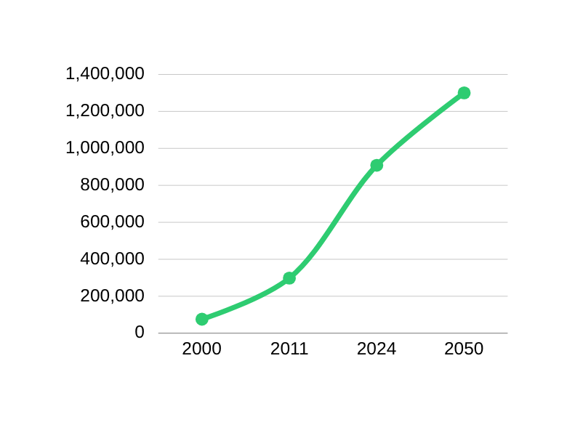
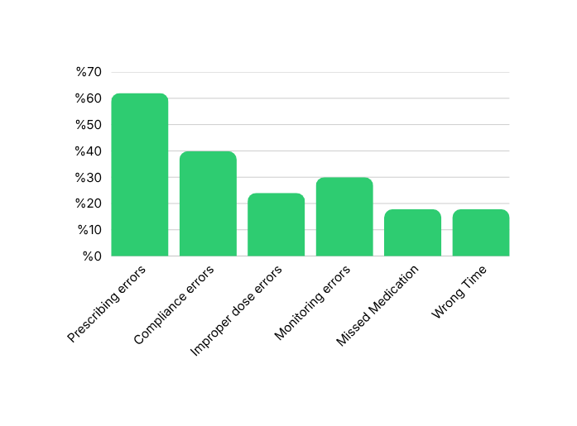
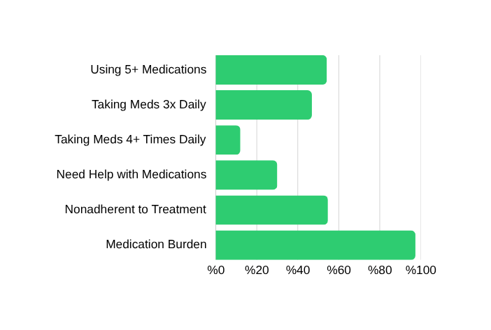
ISTSEH
SECTION 04 · PROBLEM / NEED
06 / 31
Key Statistics and Market Evidence
Chronic Diseases Drive Higher Hospital Use in Kuwait
Number of adults (20–79 years) with diabetes in Kuwait
Medication Errors In Kuwait (2021)
Source: Frontiers
Source: International Diabetes Federation
Source: Frontiers
This graph shows how common complex medication routines are among older patients in Kuwait, including multiple medicines, frequent daily doses, need for help, and nonadherence.
This graph shows the rising number of adults aged 20–79 with diabetes in Kuwait from 2000 to the projected figure for 2050.
This graph shows the most reported types of medication errors in Kuwait, including prescribing errors, wrong dose, missed medication,
and wrong-time use.
Company Report · INJAZ / JA Company Program ISTSEH
Notes:
6

Slide 7

ISTSEH
SECTION 05 · TARGET USERS
07 / 31
Target Users
ISTSEH supports patients, older adults, caregivers, who manage complex medication routines.
PERSONA 01
PERSONA 02
PERSONA 03
PERSONA 04
[Chronic-care patient]
[Older adult]
[Family caregiver]
[Pharmacist partner]
Age: 25 - 65
Age: 65+
Age: 25 – 45
Age: N/A
Role: Manages long-term medications
Role: Daily medicine user
Role: Supports a parent or family member
Role: Potential B2B customer/partner
PROFILE
PROFILE
PROFILE
PROFILE
Lives with one or more chronic conditions such as diabetes, hypertension, asthma, or heart disease.
Takes several medicines daily and may need support remembering when and how to take them.
Helps monitor medications, appointments, allergies, and chronic conditions for someone else.
Clinics, hospitals, insurance providers, or corporate wellness programs that support patients with chronic conditions.
NEEDS
NEEDS
NEEDS
NEEDS
Clear personalized dose timing, medication information, refill reminders, and safety alerts.
Simple reminders, easy-to-read and maintain schedules, caregiver support, and clear instructions.
Remote visibility, shared schedules, missed-dose alerts, and patient profile management.
Better medication adherence, patient follow-up, safety-risk tracking, and tools that reduce avoidable care gaps.
FRUSTRATIONS
FRUSTRATIONS
FRUSTRATIONS
FRUSTRATIONS
Forgets doses, feels confused by instructions, struggles to organize multiple medicines, and worries about unsafe combinations or allergy-related warnings.
Complex routines, small medication labels, memory gaps, uncertainty about missed doses, and too many medications.
Does not always know if medicine was taken, struggles to keep track while at work, and worries about safety.
Missed doses and unclear medication instructions can lead to preventable complications, repeat visits, and higher care costs, giving healthcare organizations a financial reason to support better medication management.
Company Report · INJAZ / JA Company Program ISTSEH
Notes:
7

Slide 8
ISTSEH
SECTION 06 · PRODUCT / SERVICE
08 / 31
Product / Service Idea
HOW ISTSEH WORKS
Step 01
Step 02
Step 03
Add health profile
Build medication plan
Follow daily care safely
The user adds basic health details such as allergies, chronic conditions, daily routine times, and caregiver connection if needed. This allows ISTSEH to understand the person behind the medication list, not just the medicine names.
Users can add medicines manually, search for medication information, or use image-based recognition. ISTSEH then helps organize key details such as dose timing, food instructions, reminder times, and whether the medicine is taken daily or only when needed.
The Today page shows the user’s scheduled doses and appointments in a clear daily view. ISTSEH sends reminders, tracks taken or skipped doses, and displays safety warnings when there may be duplicate ingredients, allergy risks, or medication interaction concerns.
Optional Step
Add a family member
ISTSEH also allows a user to add a family member and manage their medication care as a caregiver. This feature is designed for people who support an elderly parent, child, or relative who may need help remembering medicines, understanding schedules, or staying consistent with daily care, the caregiver creates a family member profile, adds the person’s basic medical details such as allergies, chronic conditions, routine times, and medications, then manages reminders and appointments on their behalf. This means the app can support both independent patients and family-supported patients without making the experience complicated.
iOS · iPhone · iPad
Company Report · INJAZ / JA Company Program ISTSEH
Notes:
8

Slide 9

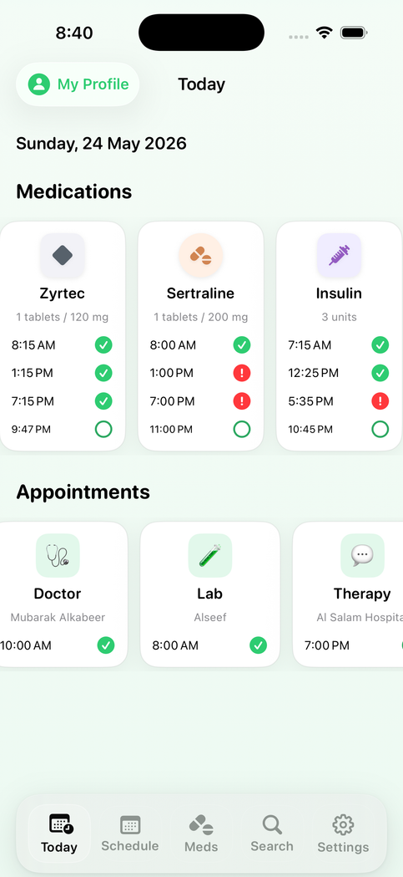
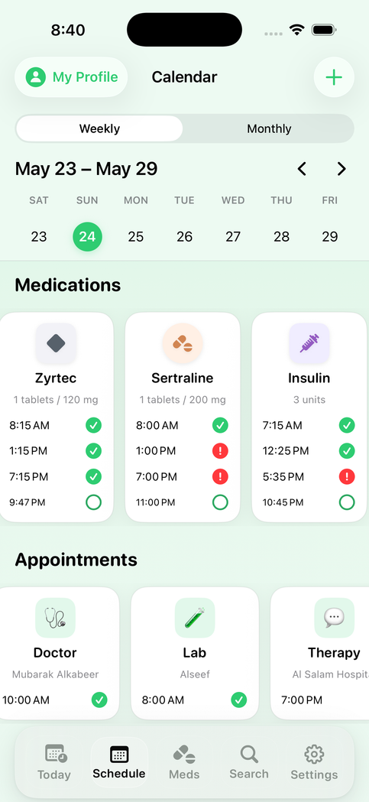
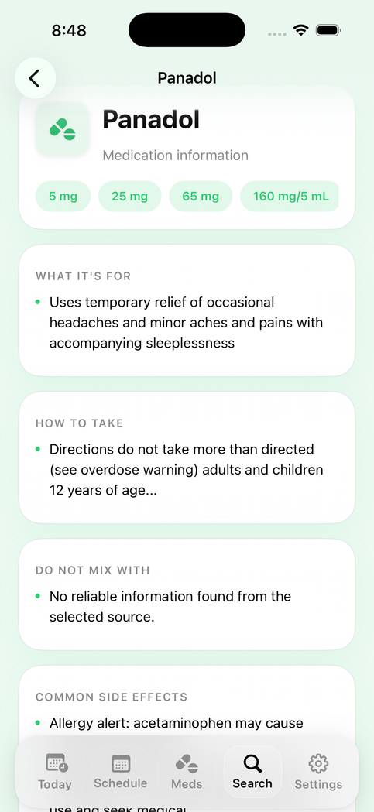
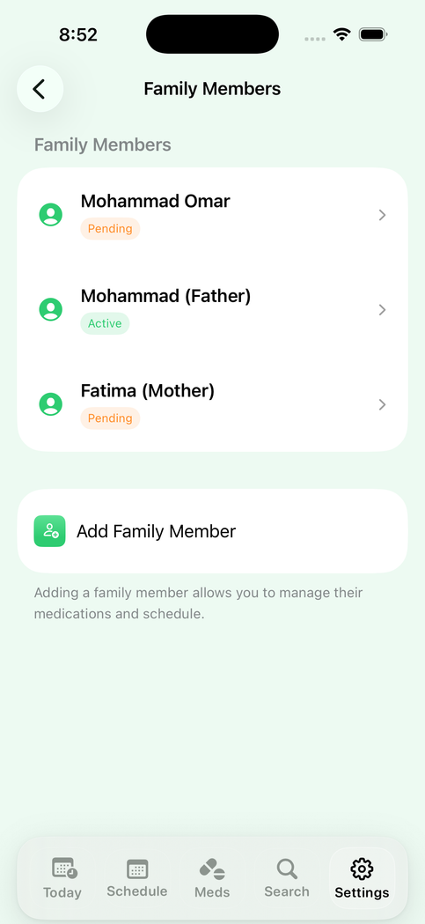
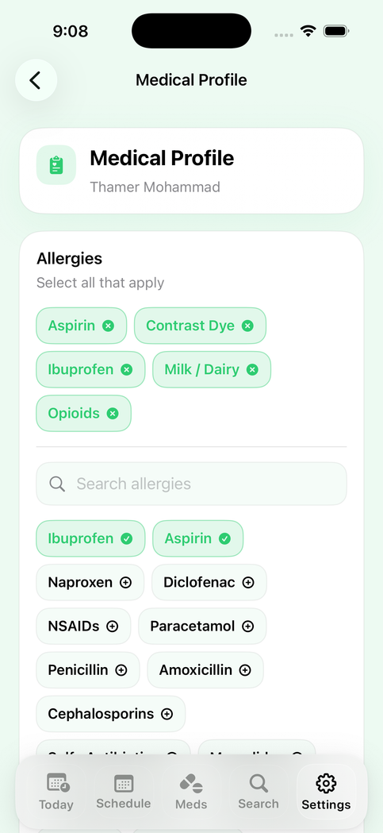
ISTSEH
SECTION 06 · APP PREVIEW
08 / 31
App Preview
iOS · iPhone · iPad
Today Page
Calendar Page
Search Page
Family Members (caregiver)
Medical Profile
Company Report · INJAZ / JA Company Program ISTSEH
Notes:
8

Slide 10








ISTSEH
SECTION 07 · KEY FEATURES
09 / 31
Key Features
ISTSEH combines reminders, smart scheduling, safety checks, and caregiver support into one medication-care system designed for patients and families.
Medication reminders
Adaptive alerts
Smart routine-based schedule
Daily and weekly views organize every dose clearly, with taken, skipped, and missed-dose tracking.
Alerts adapt to medication timing, appointments, routine changes, and important safety moments.
Builds dose timing around wake time, meals, bedtime, food rules, and caregiver-supported care plans.
Caregiver connection
Safety warnings
Medication search
Family members can support patients, manage medication plans, and monitor care through linked profiles.
ISTSEH checks medications against allergies, duplicate ingredients, and possible interaction risks before saving.
Users can search for medicines and view simplified information from verified medication data sources.
Medical profile
AI medication guide
Secure health data
Each user has a medical profile for allergies, chronic conditions, routine times, and emergency details.
The assistant helps explain medication information, schedule instructions, and safety notes in simple language.
Protects personal medication records, medical profile details, and caregiver access with privacy-focused account controls.
Notes:
9

Slide 11
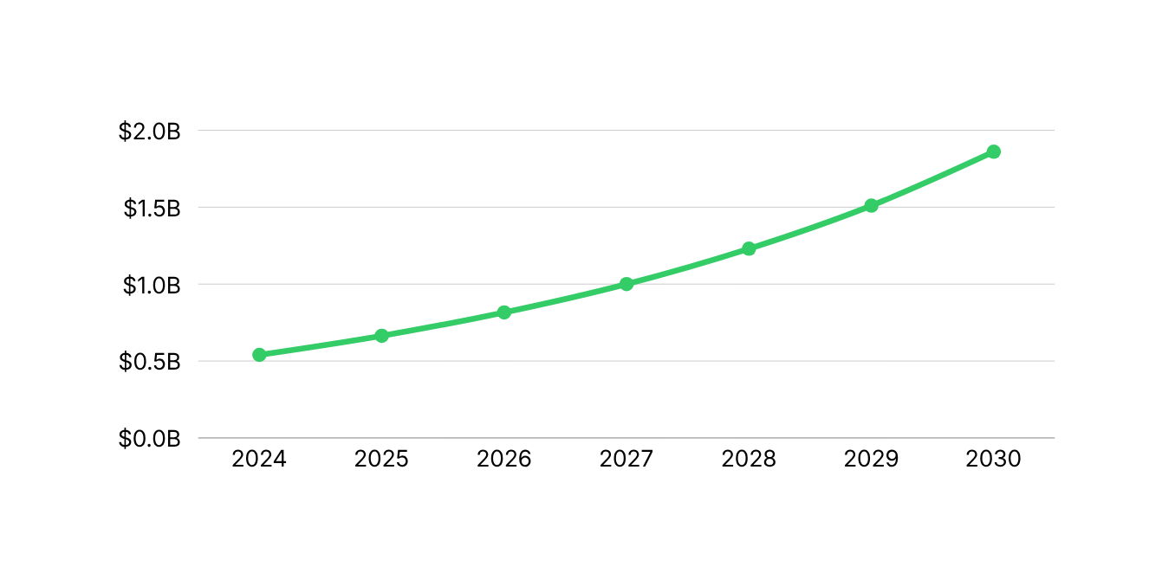
ISTSEH
SECTION 08 · MARKET RESEARCH
10 / 31
Market Research
TAM
SAM
SOM
$540.3M
$71M
$1.1M
Kuwait digital health market
Kuwait mHealth apps market
SOM was estimated using the projected 2024 Kuwait mHealth apps market and a realistic early capture rate: SOM = SAM₍2023₎ × (1 + CAGR)ⁿ × Capture Rate = $60.7M × (1 + 15.9%)¹ × 1.5% = $1.055M ≈ $1.1M. This means ISTSEH’s obtainable market is estimated as 1.5% of the projected 2024 Kuwait mHealth apps market, using the reported 2023 market size and CAGR to project one year forward.
Source: Oxford Business Group
Source: Grand View Horizon
KEY TAKEWAYS
Fast Market Growth
Kuwait’s mHealth apps market is projected to grow from $60.7M to $170.4M by 2030.
Strong Product Fit
Projected Growth of Kuwait’s mHealth Apps Market
ISTSEH fits within the mHealth apps market by focusing on personalized scheduling, health profiles, and safety support.
Company Report · INJAZ / JA Company ProgramISTSEH
Notes:
10

Slide 12






ISTSEH
SECTION 09 · USER RESEARCH
11 / 31
User Research and Survey
RESPONDENTS
INTERVIEWS
METHOD
PERIOD
81 collected / 150 target
0
Online bilingual survey
May 11 - 26, 2026
TOP SURVEY FINDING
USER QUOTES
“I don’t personally have a chronic disease, but my parents has asthma, diabetes, and high blood pressure.”
Aged between 18-24 (87.7%)
Survey respondent, Kuwait
Have a close family member with chronic disease (72.8%)
“My family member takes several medicines daily.”
Survey respondent, Kuwait
“I have allergies to ibuprofen and certain foods.”
Take or know someone who takes 3+ medications daily (64.1%)
Survey respondent, Kuwait
“Medication is part of our family’s daily routine.”
Survey respondent, Kuwait
Have allergies (48.0%)
LEARNINGS
Have a chronic disease personally (23.5%)
The survey shows that medication-care needs often extend beyond the individual. Many respondents reported family chronic disease, multiple-medication use, and allergy concerns, supporting ISTSEH’s focus on reminders, safety warnings based on health. profiles, and caregiver support.
Company Report · INJAZ / JA Company Program ISTSEH
Notes:
11

Slide 13

ISTSEH
SECTION 10 · COMPETITOR ANALYSIS
12 / 31
Competitor Analysis
Feature
Medisafe
MyTherapy
DawaTime
[Medication reminders]
YES
YES
YES
YES
[Caregiver mode]
YES
YES
NO
NO
Personalized scheduling
YES
NO
NO
NO
[Refill tracking]
YES
YES
NO
YES
[Drug interaction alerts]
YES
NO
NO
NO
[Offline access]
YES
YES
LIMITED
NO
[Localization / Arabic]
YES
NO
NO
YES
[Pricing tier]
Free + Premium
Free + Premium
Free
Free
[User’s data security]
Fully encrypted and protected by policies
Protected
No clear policies
No clear policies
Company Report · INJAZ / JA Company ProgramISTSEH
Notes:
12

Slide 14

ISTSEH
SECTION 11 · UNIQUE VALUE
13 / 31
Unique Value Proposition
UVP STATEMENT
ISTSEH is not only a pill reminder. It is a medication-care assistant that combines personalized scheduling, safety warnings, caregiver support, and secure health profiles for Kuwait/GCC families.
FOR WHOM
WHAT WE OFFER
WHY IT MATTERS
HOW WE ARE DIFFERENT
Patients, elderly users, and family caregivers who manage daily medications, chronic conditions, allergies, appointments, or multiple treatment routines.
A connected medication-care system that organizes dose schedules, reminders, medication details, medical profiles, safety checks, and caregiver access in one app.
Medication care becomes risky when users forget doses, misunderstand instructions, take multiple medicines, or have allergies that affect safety.
ISTSEH builds schedules around real routines, meals, food rules, dose spacing, and safety checks, with caregiver support, Arabic/GCC usability, and privacy-focused data management.
Company Report · INJAZ / JA Company Program ISTSEH
Notes:
13

Slide 15
ISTSEH
SECTION 12 · BUSINESS MODEL
14 / 31
Business Model
STREAM 02
STREAM 01
STREAM 03
STREAM 04
Freemium
Subscription
Partnerships
B2B licensing
Free users get basic medication reminders and basic medication search, helping ISTSEH attract users before converting them to paid plans.
Monthly paid plans unlock personalized scheduling, medical profiles, safety warnings, refill reminders, and medication history.
Start with local pharmacies for refill support and trusted service links, then expand to clinics, hospitals, and insurers for patient follow-up, adherence support, and care coordination.
Offer ISTSEH as a paid medication-care platform for clinics, hospitals, elderly-care centers, and insurers to help them monitor patient adherence, manage follow-ups, and support caregivers.
PRICING TIERS
MOST POPULAR
Freemium
Care+
Family
$0
$6
$8
per month
per month
per month
Basic medication reminders
Basic medication search
Simple daily medication list
Limited saved medications
Personalized medication scheduling
Medical profile for allergies and conditions
Safety warnings before adding medications
Refill reminders
Medication history
Care+ features for main user
Add up to 2 family members
Caregiver access and permissions
Shared medication schedules
Family safety support
2$ per additional family member
Company Report · INJAZ / JA Company Program ISTSEH
Notes:
14

Slide 16
ISTSEH
SECTION 13 · COMPANY STRUCTURE
15 / 31
Company Structure
CEO
CHIEF EXECUTIVE
Thamer Alrasheed
CMO
CFO
CDO
COO
CTO
Marketing - Finanace - Design - Operations
TECH
Thamer Alrasheed
Aida Almashooq
Leads marketing strategy, financial planning, product design direction, and daily operations to ensure ISTSEH is well-positioned, financially realistic, and professionally executed.
Builds ISTSEH’s local medication dataset, develops API infrastructure, and manages backend technology to reduce reliance on online sources and enable future B2B services.
ADVISORS AND MENTORS
We sincerely thank Prof. Mohammad Samoui from Kuwait University for his valuable guidance and support, his feedback helped us refine ISTSEH’s direction and move forward with confidence.
Company Report · INJAZ / JA Company Program ISTSEH
Notes:
15

Slide 17
ISTSEH
SECTION 14 · PROJECT MANAGEMENT
16 / 31
Project Management
PROGRAM TIMELINE · PLACEHOLDER
M1
M2
M3
M4
M5
M6
M7
Kickoff
Research
Prototype
Build
Test
Pilot
Launch Prep
WORKSTREAMS
Product
Marketing
OPERATING SYSTEM
Owner: Tech / Product team
Owner: Marketing team
Status: Core app prototype built; medication reminders, scheduling, search, safety checks, and caregiver features are being refined.
Status: Branding, competitor analysis, survey insights, pricing, and launch positioning prepared for Kuwait/GCC users.
Plan: Weekly priorities and task ownership
Build: Prototype, design, and backend progress
Review: Advisor feedback and quality checks when needed
Finance
Operations
Owner: Finance team
Owner: Operations team
Improve: User feedback, fixes, and next actions
Status: Pricing model, early operating budget, cost assumptions, and break-even analysis developed.
Status: Manages internal workflows, team coordination, task tracking, documentation, quality control, and day-to-day execution to keep ISTSEH running efficiently.
Company Report · INJAZ / JA Company Program ISTSEH
Notes:
16

Slide 18
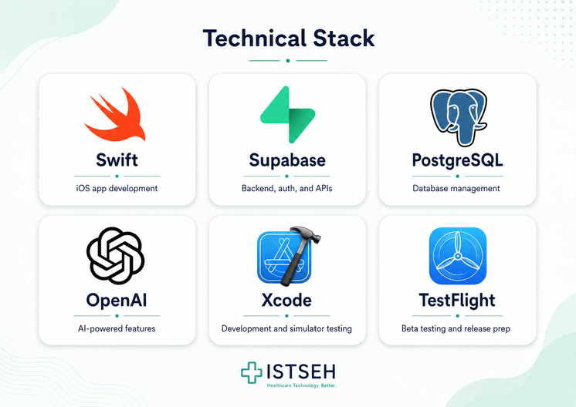
ISTSEH
SECTION 15 · DEVELOPMENT
17 / 31
Production and Development
BUILD PROCESS
01
Discovery and research
Medication Data Strategy
Identified the medication-care problem, reviewed chronic disease and medication safety needs, and studied existing solutions in Kuwait, GCC, and global markets.
ISTSEH is building a local medication dataset and future API infrastructure to reduce reliance on online sources. This positions ISTSEH not only as a medication-care app, but also as a trusted medication information service provider for future B2B opportunities.
02
User Survey and Validation
Collected user feedback to understand medication habits, family health needs, allergy concerns, and demand for caregiver-supported medication management.
03
Brand and Identity Design
QUALITY AND TESTING
Developed ISTSEH’s name, visual identity, colors, app tone, and Arabic-friendly healthcare design to build trust with patients and families.
ISTSEH is tested through manual app testing, simulator checks, user-flow reviews, and feedback cycles. Testing focuses on reminders, schedule accuracy, safety warnings, caregiver access, search quality, data syncing, and early hands-on user feedback to ensure the app matches real user needs
04
Requirements and App’s Initial Design
Defined the app’s core requirements, user flows, screen structure, medication entry process, reminder logic, safety-warning experience, and caregiver journey.
05
Technical Development
Built the SwiftUI iOS app with backend support, including medication reminders, personalized scheduling, search, medical profiles, caregiver access, and safety checks.
06
Testing and Release Preparation
Tested core flows, reminders, data syncing, family profiles, safety warnings, and UI consistency before preparing the product for pilot users.
Company Report · INJAZ / JA Company Program ISTSEH
Notes:
17

Slide 19
ISTSEH
SECTION 17 · MARKETING
19 / 31
Marketing Report
POSITIONING STATEMENT
For Kuwait/GCC patients and caregivers, ISTSEH makes medication care safer and easier through reminders, personalized scheduling, safety warnings, and family support. This is especially important in Kuwait, where chronic disease burden is high: diabetes affects about 25.6% of adults, and 73.3% of adults are overweight or obese, increasing the need for organized long-term medication care.
BRAND PILLARS
CHANNELS AND TACTICS
Pillar 1
Pillar 2
Awareness
Safety
Family Care
Instagram, TikTok, and short videos showing medication problems, caregiver stories, and app demos.
Medication reminders, allergy awareness, interaction warnings, and safer medication decisions before users save or take a medicine.
Caregiver support helps family members manage medicines, schedules, permissions, and patient profiles in one connected system.
Trust Building
Pharmacists, health students, and educational content explaining reminders, safety warnings, and family care.
Pillar 3
Pillar 4
Medication Streak Rewards
Simplicity
Trust
Users build a streak by taking medications on time. Longer streaks unlock rewards such as pharmacy coupons, Care+ trial days, or subscription discounts through future partner offers.
Clean Arabic-friendly design, clear schedules, and easy medication search make the app easier for elderly users and families.
Privacy-focused health profiles, secure caregiver access, and verified medication information help users feel confident using ISTSEH.
Access
Pharmacy QR codes, university pilots, and clinic introductions to reach users in real-life healthcare settings.
Company Report · INJAZ / JA Company ProgramISTSEH
Notes:
19

Slide 20
ISTSEH
SECTION 18 · DIGITAL MARKETING
20 / 31
Digital Marketing
CONTENT CALENDAR · PLACEHOLDER
SAMPLE POST
Week
Platform
Format
Theme
CTA
[Add a social media post mockup here]
[W1]
Instagram + TikTok
Touching story video
Awareness
Follow
[W2]
Instagram
Carousel
Medication safety education
Save / Share
[W3]
TikTok + Reels
App demo
How ISTSEH works
Visit website for early discount code
[W4]
Instagram Stories
Poll / Q&A
User needs + caregiver problems
Answer poll
[W5]
App Store / Website
Launch post
Beta / pilot sign-up
Download / sign up
"[Insert sample caption / hook line here.]"
REACH
ENGAGE
Target Sign-ups
5 - 7k
8–15%
150
Pre-launch targets for awareness and early-access validation.
Company Report · INJAZ / JA Company Program ISTSEH
Notes:
20

Slide 21

ISTSEH
SECTION 19 · SALES
21 / 31
Sales Strategy
SALES FUNNEL
PARTNERSHIP CHANNELS
AWARENESS
[100%]
[Pharmacies]
[Reach]
[Owner · status · KPI]
INTEREST
[XX%]
[Clinics]
[Visits]
[Owner · status · KPI]
[Universities]
TRIAL
[XX%]
[Owner · status · KPI]
[Downloads]
[Insurance]
[Owner · status · KPI]
ACTIVATION
[XX%]
[App Store]
[Sign-ups]
[Owner · status · KPI]
PAID
[XX%]
[Conversions]
Company Report · INJAZ / JA Company ProgramISTSEH
Notes:
21

Slide 22
ISTSEH
SECTION 20 · NETWORKING
22 / 31
Networking Strategy
OUTREACH PLAN
[Stakeholder 01][Channel]
HEALTHCARE
PHARMACIES
MENTORS
[Stakeholder 02][Channel]
[Hospitals · Clinics]
[Chains · Independent]
[INJAZ · Faculty]
[Stakeholder 03][Channel]
[Stakeholder 04][Channel]
[Stakeholder 05][Channel]
CORE
[Stakeholder 06][Channel]
ISTSEH
COMMUNITY
[Patients · Caregivers]
MEDIA
INVESTORS
[Press · Influencers]
[Programs · Funds]
Company Report · INJAZ / JA Company ProgramISTSEH
Notes:
22

Slide 23
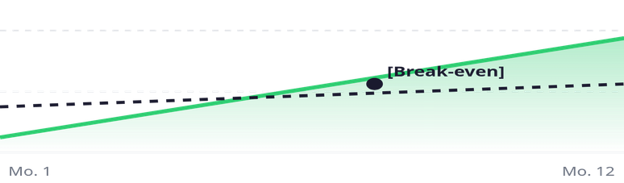
ISTSEH
SECTION 21 · FINANCIALS
23 / 31
Financial Plan
STARTUP CAPITAL
MONTHLY BURN
BREAK-EVEN
YEAR 1 REVENUE
[$X]
[$X]
[Mo. X]
[$X]
Line item
Y1
Y2
Y3
BREAK-EVEN PROJECTION
[Revenue]
[$X]
[$X]
[$X]
[Cost of goods]
[$X]
[$X]
[$X]
[Marketing]
[$X]
[$X]
[$X]
[Operations]
[$X]
[$X]
[$X]
RevenueCosts
Net profit
[$X]
[$X]
[$X]
FUNDING PLAN
[Describe how the company plans to fund operations — INJAZ seed, grants, accelerator, friends and family.]
KEY ASSUMPTIONS
[List 2-3 financial assumptions: pricing, conversion rate, churn, market capture.]
Company Report · INJAZ / JA Company ProgramISTSEH
Notes:
23

Slide 24


ISTSEH
SECTION 22 · LEGAL & ETHICAL
24 / 31
Legal and Ethical Plan
COMPLIANCE CHECKLIST
DATA PRIVACY
[Register company under INJAZ / JA program guidelines]
[Describe encryption, storage, retention, and user-deletion process for health data.]
[Comply with App Store Review Guidelines · Health & Medical]
[Apply GDPR / local data-privacy law for user health data]
ETHICAL PRINCIPLES
[Encrypt sensitive health and medication data at rest and in transit]
[Describe commitments around medication advice, consent, and accessibility.]
[Display medical disclaimer: ISTSEH is not a substitute for professional advice]
[Obtain explicit user consent before collecting health information]
[Trademark ISTSEH name and protect logo / brand assets]
DISCLAIMER
[Add Terms of Service and Privacy Policy reviewed by legal advisor]
[ISTSEH is a medication reminder, not a substitute for professional medical advice. Always consult a doctor.]
[Set policy for handling underage users and parental consent]
[Plan audit trail for data access by caregivers]
Company Report · INJAZ / JA Company ProgramISTSEH
Notes:
24

Slide 25
ISTSEH
SECTION 23 · RISK ANALYSIS
25 / 31
Risk Analysis
Risk
Likelihood
Impact
Mitigation
RISK MATRIX
[Low user adoption]
[MED]
[HIGH]
[Describe mitigation strategy.]
LOW
MED
HIGH
HIGH
[High likelihood / Low impact]
[Comp. entry]
[Data privacy breach]
[LOW]
[HIGH]
[Describe mitigation strategy.]
[Competitor entry]
[HIGH]
[MED]
[Describe mitigation strategy.]
[Regulatory change]
[LOW]
[MED]
[Describe mitigation strategy.]
[Funding shortfall]
[MED]
[HIGH]
[Describe mitigation strategy.]
MED
[Team capacity]
[Adoption · Funding]
[Team capacity]
[MED]
[MED]
[Describe mitigation strategy.]
[Technical debt]
[LOW]
[LOW]
[Describe mitigation strategy.]
LOW
[Tech debt]
[Regulatory]
[Data breach]
← LikelihoodImpact ↑
Company Report · INJAZ / JA Company ProgramISTSEH
Notes:
25

Slide 26
ISTSEH
SECTION 24 · SDG & TRACK
26 / 31
SDG and Track Connection
3
SDG 03
9
SDG 09
Good Health and Well-Being
Industry, Innovation, Infrastructure
[Explain how ISTSEH advances medication adherence and patient well-being in line with SDG 3.]
[Explain how ISTSEH contributes to digital health innovation aligned with SDG 9.]
COMPETITION TRACK
MEASURABLE IMPACT
[Insert INJAZ / JA track name]
[N]
[N]
[N]
[Explain why ISTSEH fits this track and how it meets the track's criteria.]
[Lives reached]
[Adherence %]
[Partners]
Company Report · INJAZ / JA Company ProgramISTSEH
Notes:
26

Slide 27
ISTSEH
SECTION 25 · ROADMAP
27 / 31
Roadmap
12-MONTH OUTLOOK
Q1
Q2
Q3
Q4
[Launch v1]
[Caregiver mode]
[Pharmacy pilot]
[Regional expansion]
[Describe milestone.]
[Describe milestone.]
[Describe milestone.]
[Describe milestone.]
FUTURE · 01
FUTURE · 02
FUTURE · 03
[AI medication assistant]
[Apple Watch app]
[Doctor portal]
[Describe planned feature.]
[Describe planned feature.]
[Describe planned feature.]
Company Report · INJAZ / JA Company ProgramISTSEH
Notes:
27

Slide 28

ISTSEH
SECTION 26 · REFLECTION
28 / 31
Reflection and Lessons Learned
WHAT WORKED
"[Insert a short reflection quote from a team member here.]"
[Describe what the team did well during the program — methods, decisions, and habits worth keeping.]
— [Team member, role]
WHAT WAS HARD
[Describe the biggest challenges and how the team approached them.]
SKILLS DEVELOPED
[List entrepreneurship, design, technical, and teamwork skills gained.]
WHAT WE WOULD DO DIFFERENTLY
[Describe what the team would change if they could start over — process, scope, partnerships, or focus.]
ACKNOWLEDGEMENTS
[Thank mentors, advisors, family, and the INJAZ / JA program for support.]
Company Report · INJAZ / JA Company ProgramISTSEH
Notes:
28

Slide 29
ISTSEH
SECTION 27 · APPENDICES
29 / 31
Appendices and Evidence
APPENDIX A
APPENDIX B
APPENDIX C
APPENDIX D
Survey results
User interviews
Wireframes
Brand assets
[Add survey screenshots]
[Add interview notes]
[Add wireframe images]
[Add logo and palette]
APPENDIX E
APPENDIX F
APPENDIX G
APPENDIX H
Financial model
Pitch deck
Mentor feedback
Team photos
[Add spreadsheet snapshot]
[Add deck cover]
[Add mentor notes]
[Add team photos]
Company Report · INJAZ / JA Company ProgramISTSEH
Notes:
29

Slide 30
ISTSEH
SECTION 28 · REFERENCES
30 / 31
Sources and References
MARKET AND INDUSTRY RESEARCH
COMPETITOR INFORMATION
[01] International Diabetes Federation. (2024). Kuwait Diabetes Report 2000–2050. IDF Diabetes Atlas.
[06] [Insert reference in APA / Harvard format.]
[02] World Health Organization. (2018). Noncommunicable Diseases Country Profiles: Kuwait. World Health Organization.
[07] [Insert reference in APA / Harvard format.]
[03] Alibrahim, A., et al. (2022). Noncommunicable Diseases and Hospital Utilization in Kuwait.
DESIGN AND BRAND
HEALTHCARE AND CLINICAL STUDIES
[08] [Insert reference in APA / Harvard format.]
[04] [Insert reference in APA / Harvard format.]
[09] [Insert reference in APA / Harvard format.]
[05] [Insert reference in APA / Harvard format.]
PROGRAM DOCUMENTATION
[10] [Insert INJAZ / JA program reference.]
Company Report · INJAZ / JA Company ProgramISTSEH
Notes:
30

Slide 31

ISTSEH
31 / 31 · END OF REPORT
Care worth remembering.
WEBSITE
EMAIL
INSTAGRAM
APP STORE
[istseh.app]
[app@istseh.app]
[@istseh]
[Coming soon]
Company Report · INJAZ / JA Company Program© [2026] ISTSEH
Notes:
31

